Slide 1
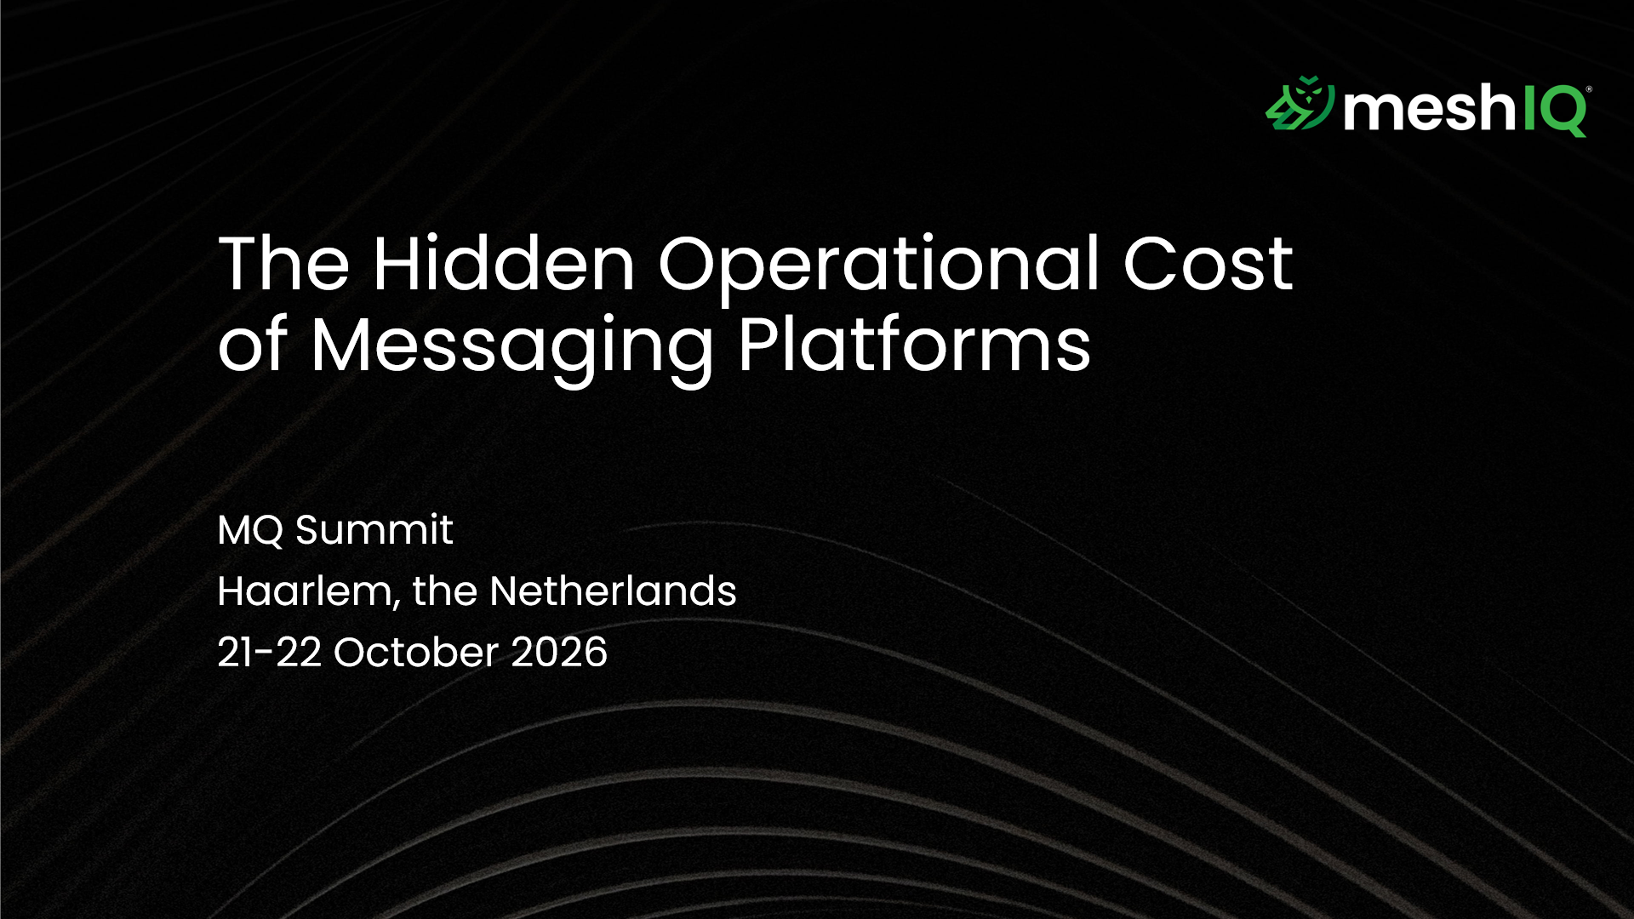
Notes:
… (title) …

Slide 2
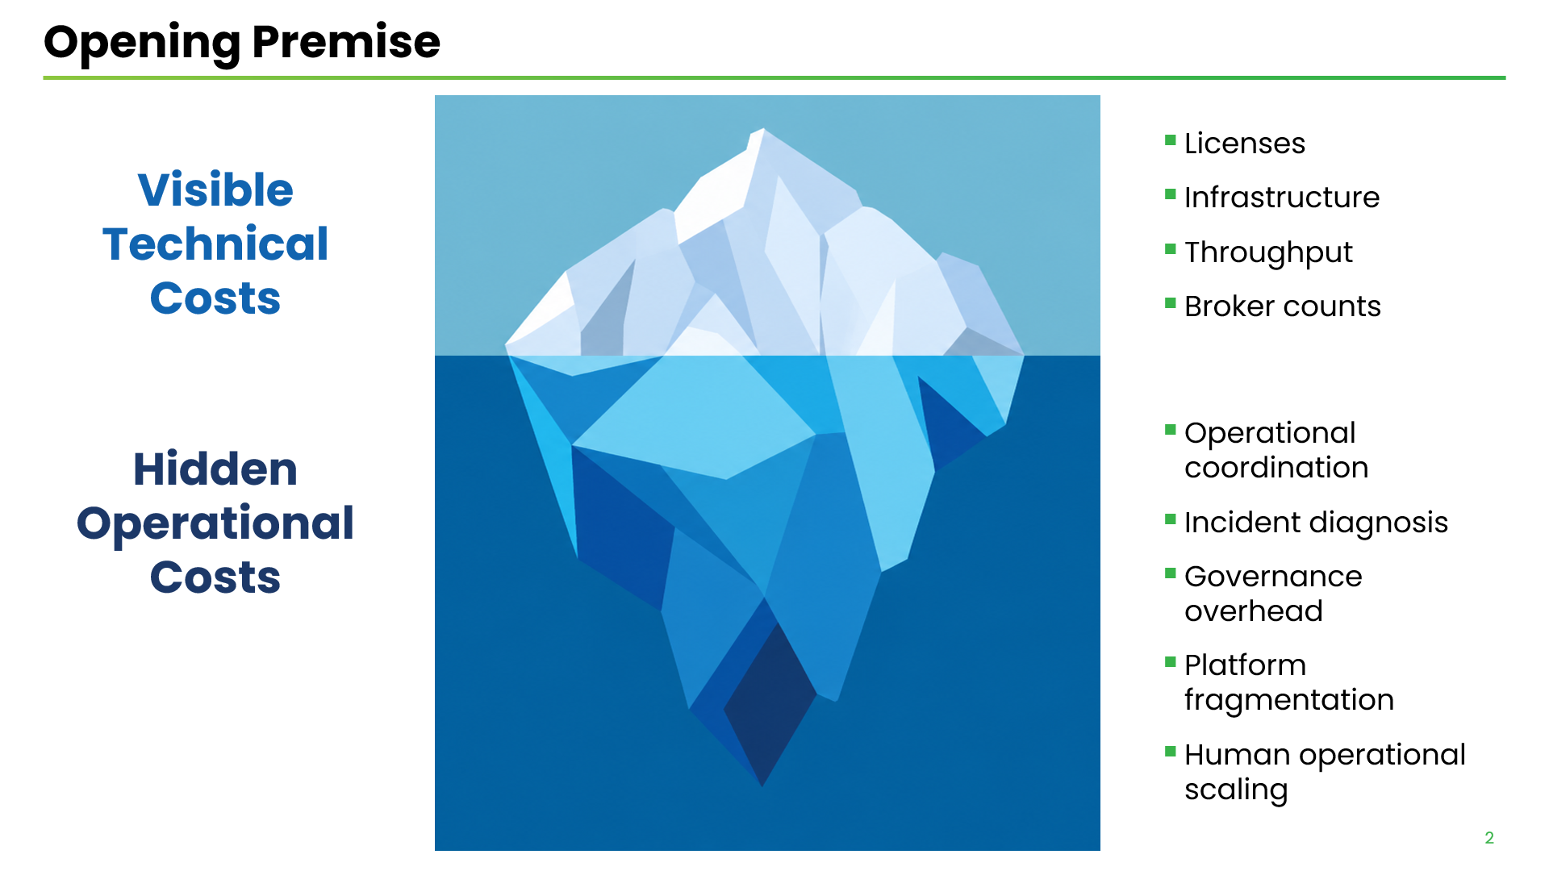
Notes:
Organizations underestimate the OPERATIONAL COST of messaging platforms.
We FOCUS on COSTS that are VISIBLE and EASILY MEASURABLE
… (bullet points) …
OPERATING messaging platforms creates another CLASS of COSTS … OPERATIONAL COSTS
… (bullet points) …
OPERATIONAL COSTS … LESS VISIBLE … HARDER to MEASURE … because “HIDDEN”
COST of OPERATING messaging platforms … LARGER than VISIBLE costs we TYPICALLY ACCOUNT FOR

Slide 3
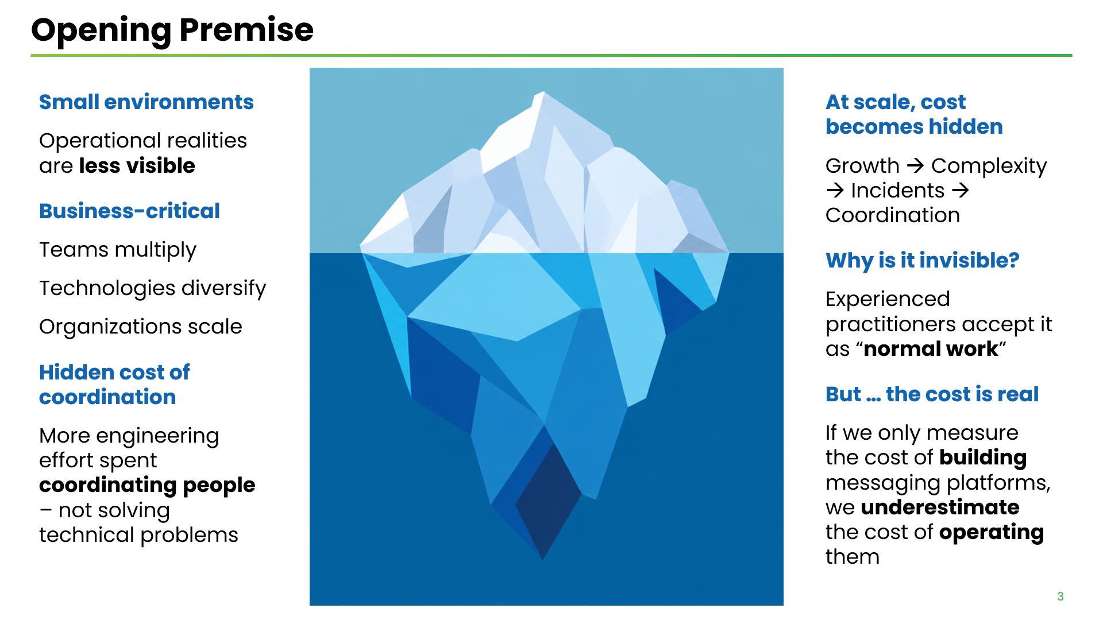
Notes:
OPERATIONAL COSTS … are LESS APPARENT … in SMALL ENVIRONMENTS
When MESSAGING becomes BUSINESS-CRITICAL … (bullet points) …
With increased SCALE … HIDDEN COSTS get LARGER … (bullet points)
Why OPERATIONAL COSTS are INVISIBLE ? … (1 bullet point)
“HIDDEN” = “NOT on PURCHASE ORDERS” … in people's CALENDARS … MEETING ROOMS … SUPPORT TICKETS … operational FRICTION … DUPLICATED WORK
These COSTS ARE NONTHELESS REAL … If we ONLY measure the cost of BUILDING messaging platforms … we UNDERESTIMATE the COST of OPERATING them

Slide 4
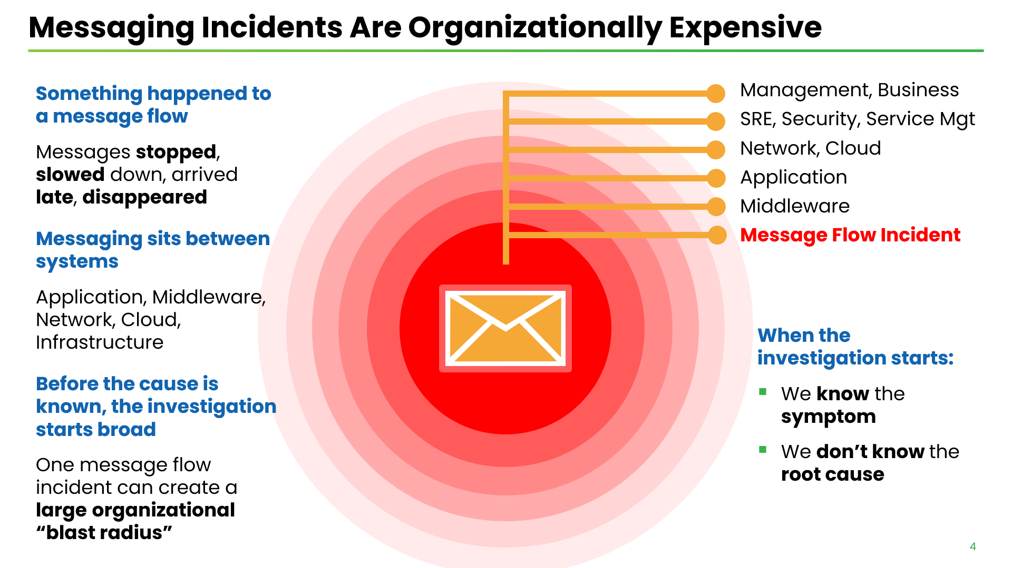
Notes:
Something happened to a MESSAGE FLOW … (bullet points) …
Messaging SITS BETWEEN SYSTEMS … messaging layer ONLY 1 of SEVERAL PLAUSIBLE AREAS of INVESTIGATION …
Investigation starts BROADLY … because root cause UNKNOWN … Investigation NARROWS ONLY as EVIDENCE is collected …
ORGANIZATIONAL “BLAST RADIUS” … Potentially LOTS of people can get involved … BEFORE we know what CAUSED it … many STAKEHOLDERS … many PARTS of the organization
… (bullet points) …
When the INVESTIGATION STARTS … (bullet points) …

Slide 5
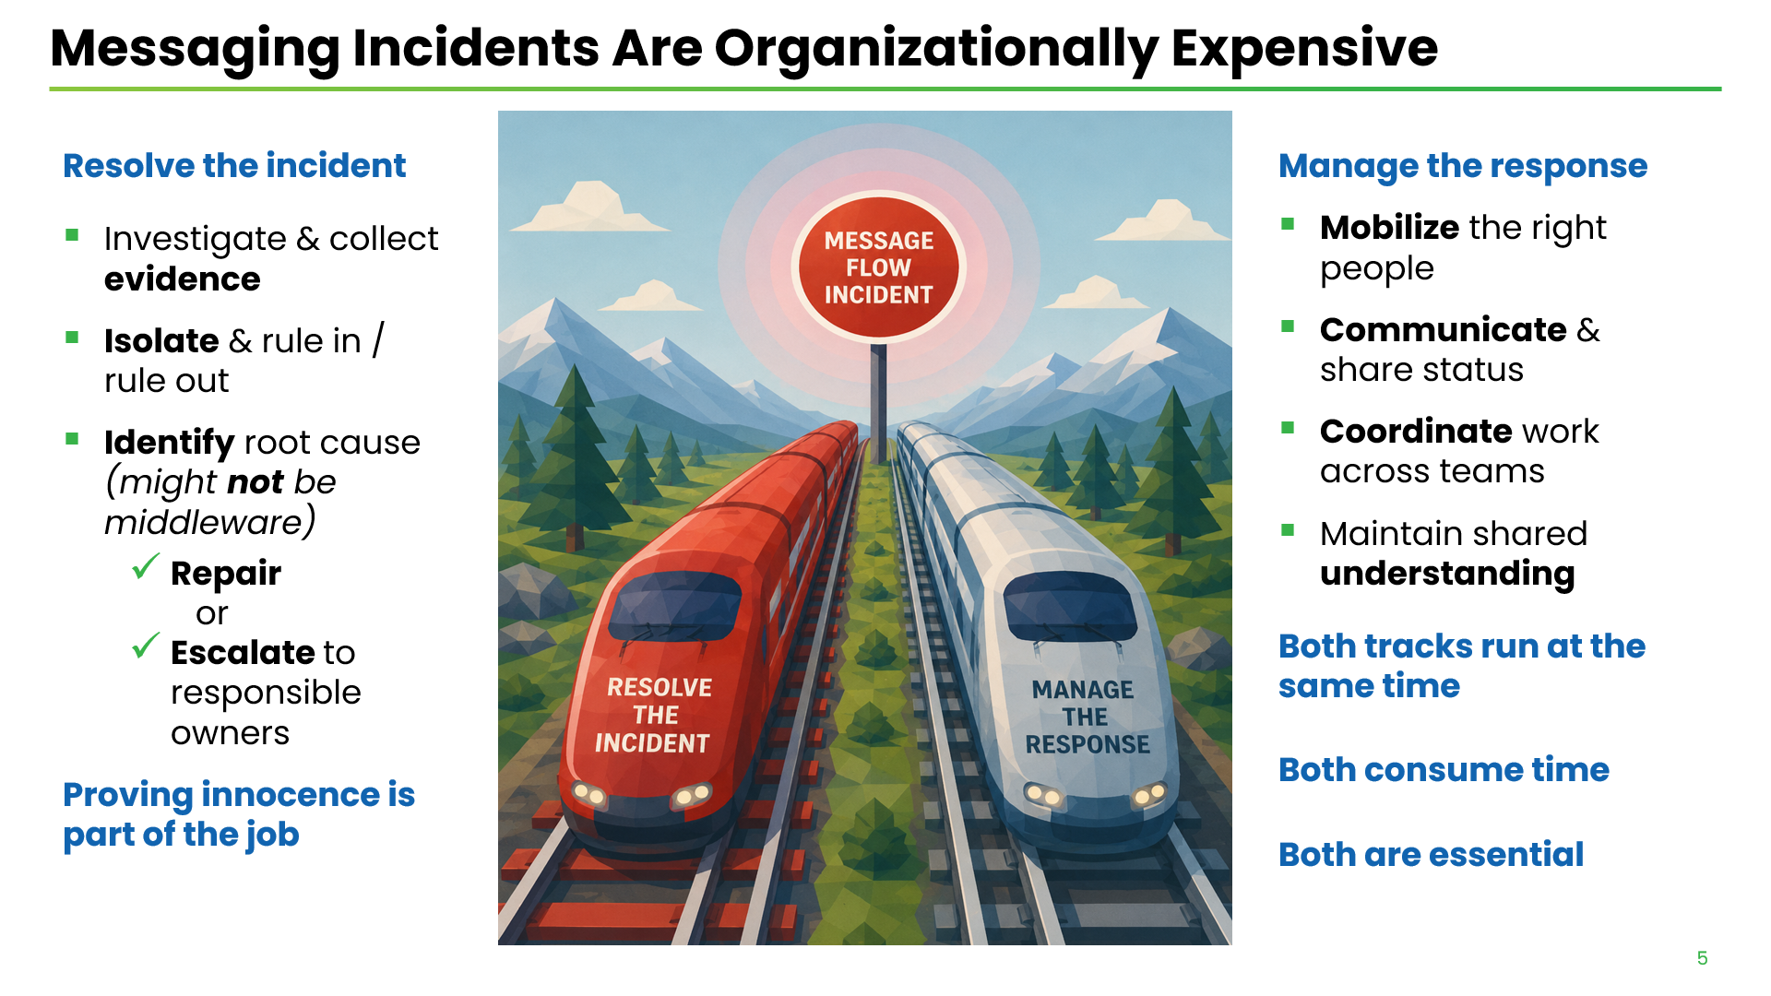
Notes:
When incident begins … 2 WORKLOADS … running at the SAME TIME
1st WORKLOAD … RESOLVE THE INCIDENT … (bullet points) …
PROVING INNOCENCE IS PART OF THE JOB ... Problem isolation is REAL WORK … even when middleware is ultimately NOT the cause
2nd WORKLOAD … MANAGE THE RESPONSE … (bullet points) …
MANAGING THE RESPONSE IS PART OF THE INCIDENT WORKLOAD
BOTH WORKLOADS consume TIME … both are ESSENTIAL to RESOLVING incident

Slide 6
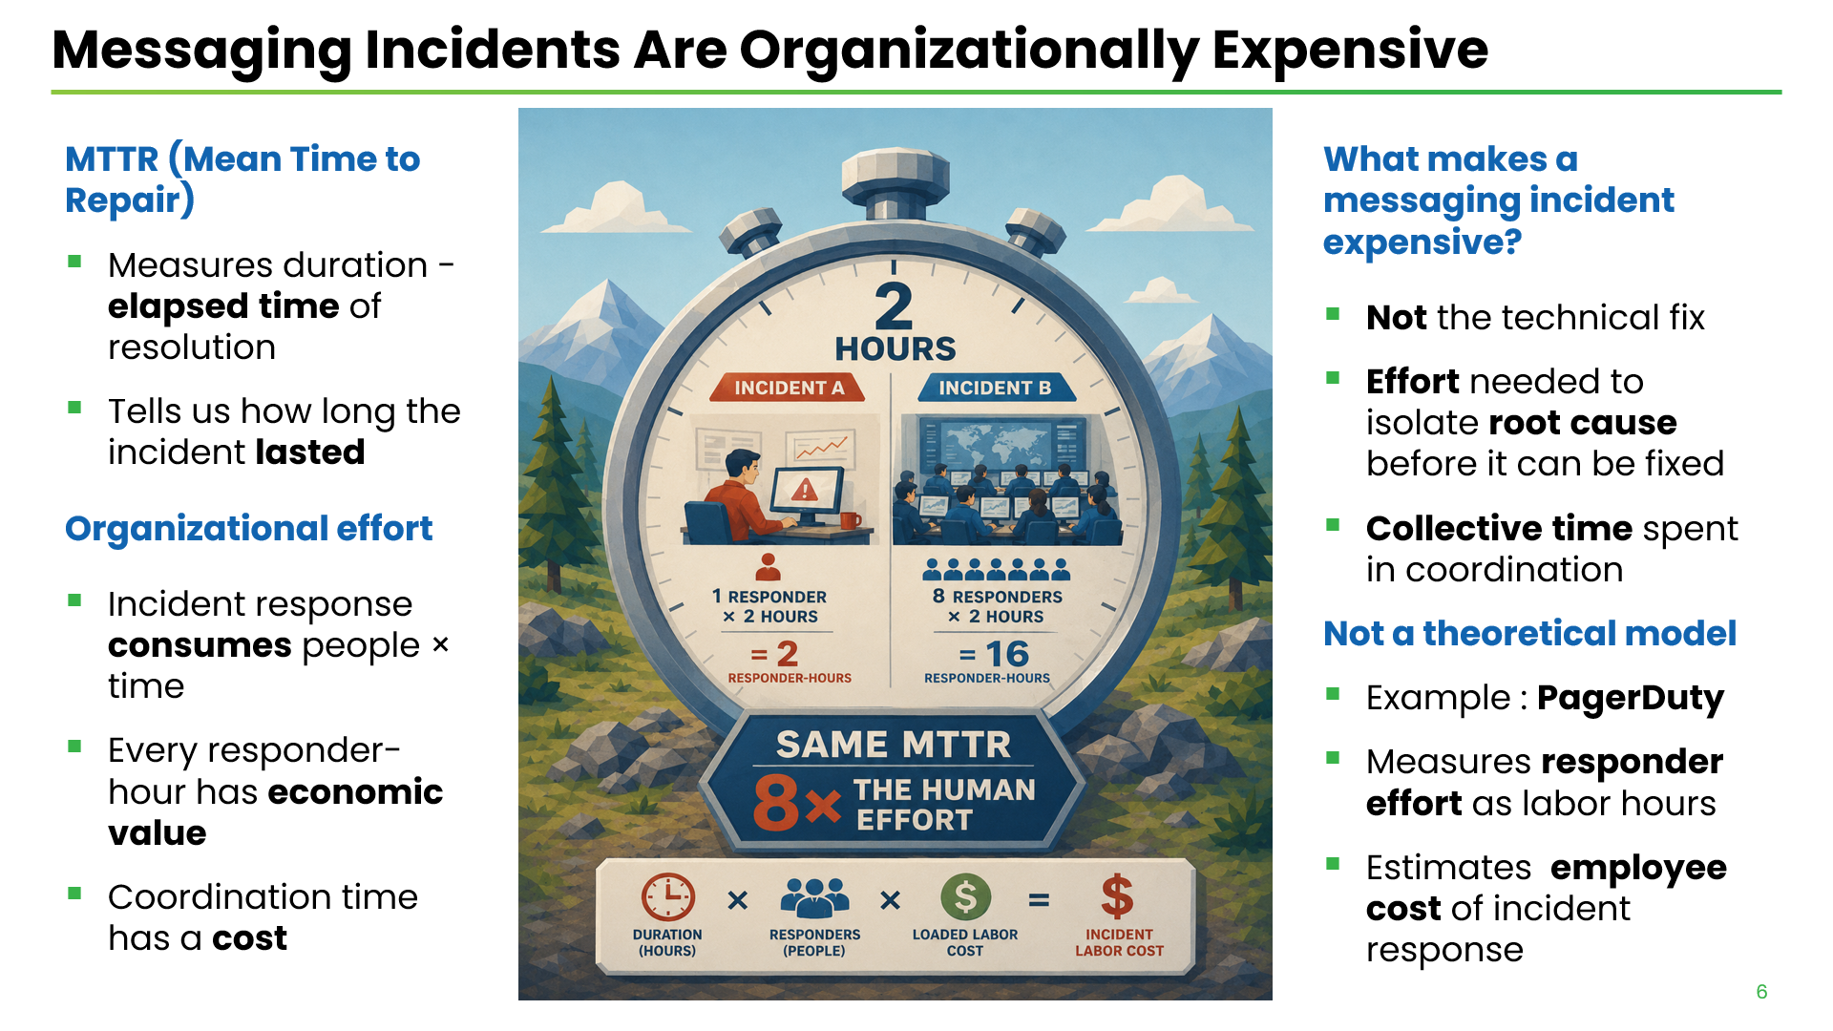
Notes:
We USUALLY MEASURE incidents using MTTR … (bullet points) …
But DURATION doesn't tell us how much ORGANIZATIONAL EFFORT was SPENT
GRAPHIC : 2 incidents … both lasted exactly TWO HOURS
Incident A … 1 RESPONDER … 2 RESPONDER-HOURS
Incident B … 8 RESPONDERS … 16 RESPONDER-HOURS
SAME MTTR … 8 X the HUMAN EFFORT
ORGANIZATIONAL EFFORT is MEASURABLE … Each RESPONDER-HOUR has a COST
What makes a MESSAGING INCIDENT EXPENSIVE ? … (bullet points) …
NOT THEORY… PAGERDUTY … measures RESPONDER EFFORT and LABOR HOURS … the EMPLOYEE COST of incident RESPONSE
Need to think ECONOMICALLY about RESPONSE EFFORT … NOT just MTTR.

Slide 7
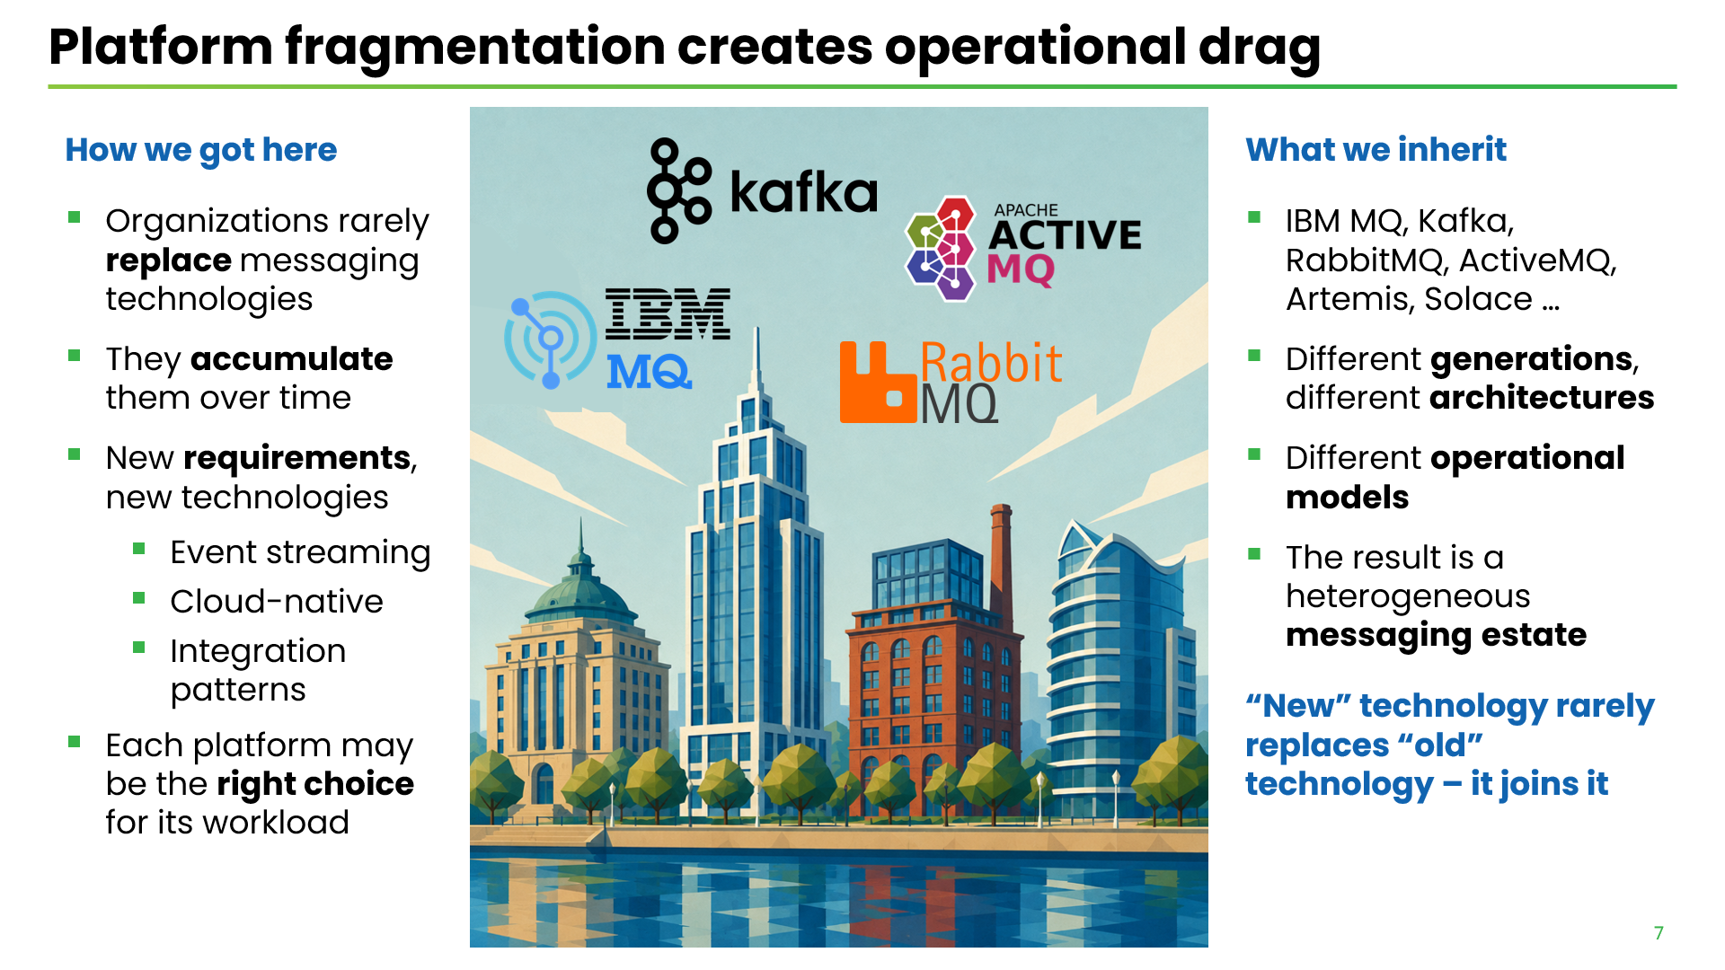
Notes:
Organizations RARELY REPLACE messaging technologies … they ACCUMULATE them
ESTABLISHED platforms continue supporting TRANSACTIONAL WORKLOADS
NEW REQUIREMENTS emerge … (bullet points) …
New TECHNOLOGIES … are ADDED to address NEW REQUIREMENTS … (bullet points) …
EACH TECHNOLOGY DECISION is perfectly RATIONAL
Different messaging TECHNOLOGIES solve DIFFERENT PROBLEMS
Like a CITY … different buildings … built at different times … different purposes
What we INHERIT through this EVOLUTION … (bullet points) …
RESULT : a heterogeneous MESSAGING ESTATE

Slide 8
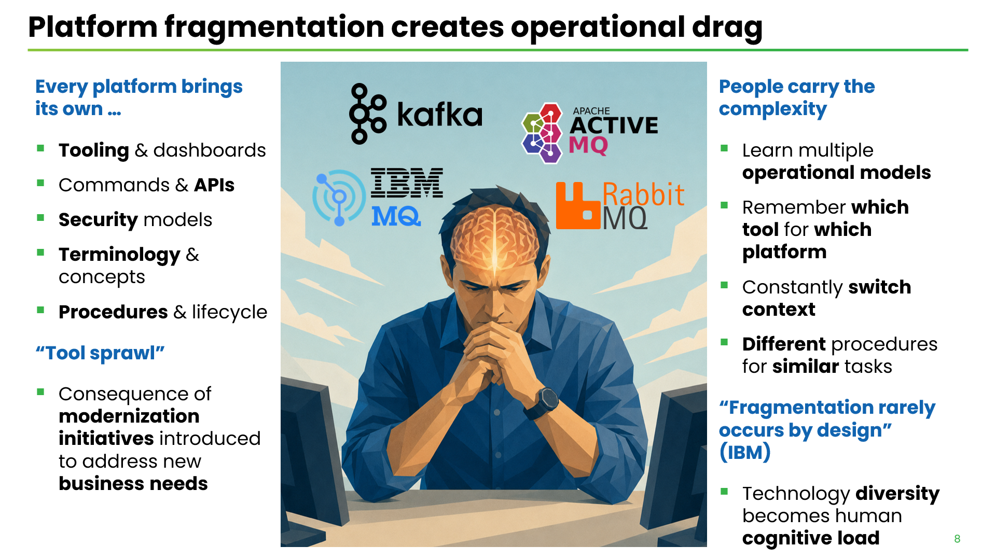
Notes:
Each MESSAGING PLATFORM brings its own OPERATIONAL MODEL … (bullet points) …
TOOL SPRAWL … (bullet points) … in many cases, UNAVOIDABLE
DIVERSITY is NOT a PROBLEM … the PROBLEM is that PEOPLE have to carry the COMPLEXITY …
… (bullet points) …
PLATFORM FRAGMENTATION does not happen by DESIGN … DIVERSITY leads to COMPLEXITY … and COMPLEXITY ultimately lands in somebody's HEAD … (COGNITIVE LOAD)
… (next slide) … : [FRAGMENTATION not only makes humans work harder … it can also cause the SAME OPERATIONAL PROBLEMS to be solved AGAIN … AND AGAIN … in DIFFERENT PARTS of the ORGANIZATION]

Slide 9
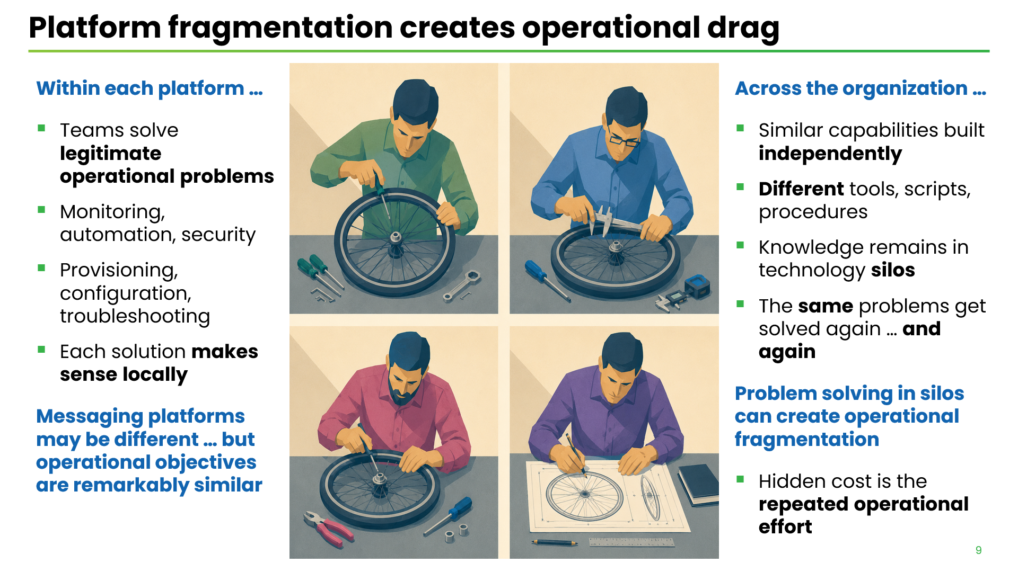
Notes:
Within EACH PLATFORM … TEAMS
… (bullet points)
But … ACROSS the ENTIRE ORGANIZATION … Each team solving the SAME KINDS OF PROBLEMS … but using DIFFERENT
… (bullet points) …
IMPLEMENTATIONS may be DIFFERENT … because the TECHNOLOGIES are DIFFERENT … but the OPERATIONAL OBJECTIVES are REMARKABLY SIMILAR
NOBODY DECIDED: “LET'S DUPLICATE this WORK” … but without DELIBERATE GOVERNANCE, organizations gradually build MULTIPLE SOLUTIONS to the SAME operational PROBLEMS …

Slide 10
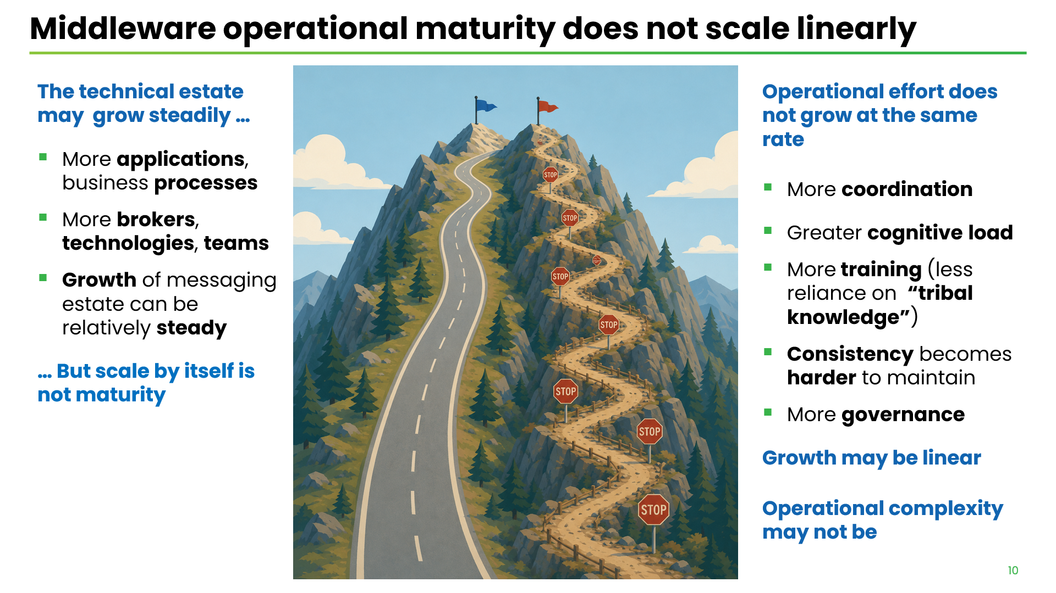
Notes:
As new BUSINESS requirements EMERGE … TECHNICAL ESTATE may grow relatively STEADILY
… (bullet points) …
But SCALE by ITSELF is not MATURITY
ORGANIZATIONAL EFFORT doesn't necessarily grow at the SAME RATE
… (bullet points) …
If reliance on MANUAL COORDINATION … TRIBAL KNOWLEDGE … INCONSISTENT OPERATIONAL PRACTICES … GROWTH of operational COMPLEXITY can quickly OUTPACE growth of the ESTATE

Slide 11
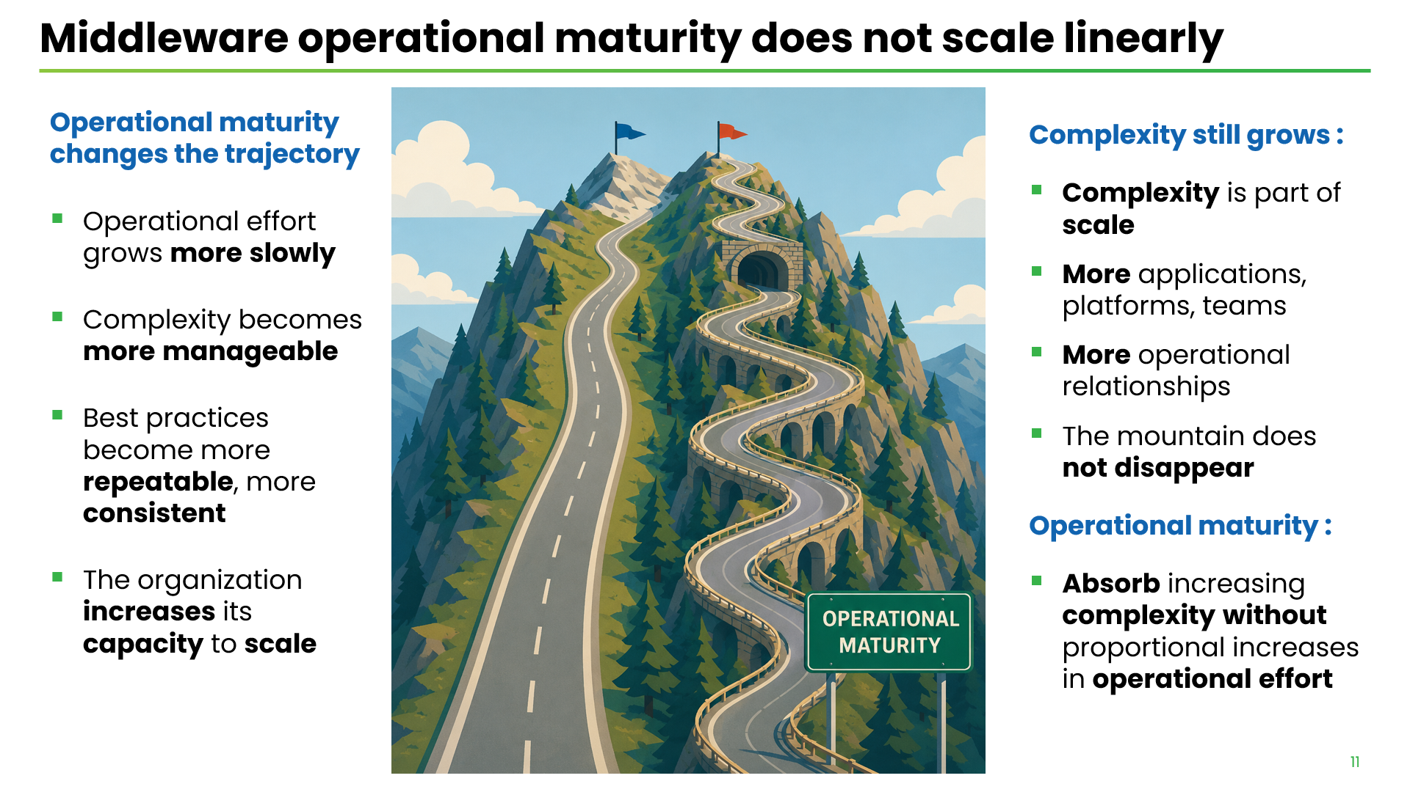
Notes:
Operational MATURITY CHANGES that TRAJECTORY
… (bullet points) …
COMPLEXITY still GROWS
It’s NOT about ELIMINATING COMPLEXITY … it's about increasing the organization's ABILITY TO MANAGE IT
… (bullet points) …
Operational MATURITY … (1 bullet point) …
TRUE MEASURE of OPERATIONAL MATURITY is NOT how LARGE the messaging estate becomes … but how LITTLE ADDITIONAL OPERATIONAL EFFORT is REQUIRED as it GROWS

Slide 12
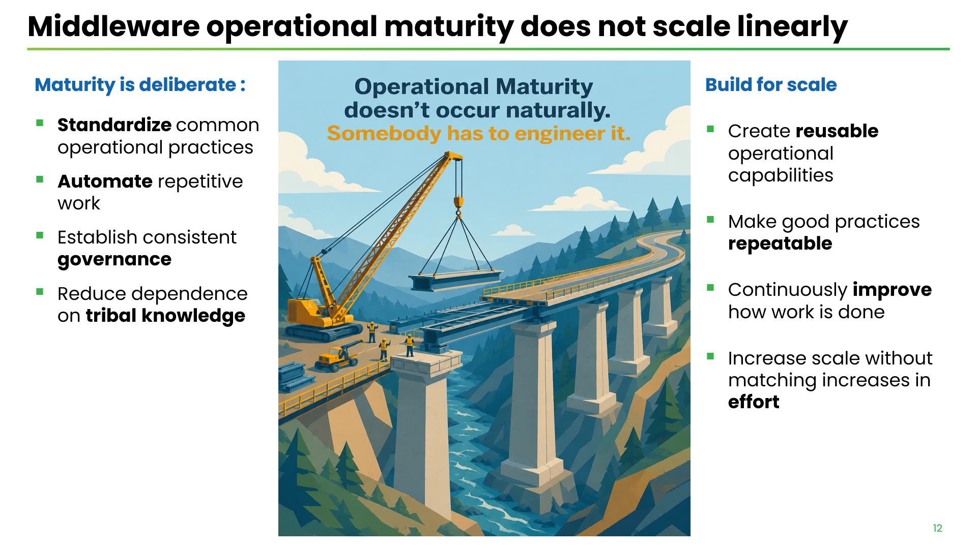
Notes:
Increased SCALE is ORGANIC … but OPERATIONAL MATURITY is DELIBERATE
… (bullet points) …
Organizations don't become OPERATIONALLY MATURE simply because they've operated messaging infrastructure for a LONG TIME … SOMEBODY has to ENGINEER IT (Google's Site Reliability Workbook)
Build for SCALE
… (bullet points) …
Being able to ABSORB MORE COMPLEXITY without requiring proportionally MORE OPERATIONAL EFFORT ... THAT'S what we're trying to ENGINEER

Slide 13
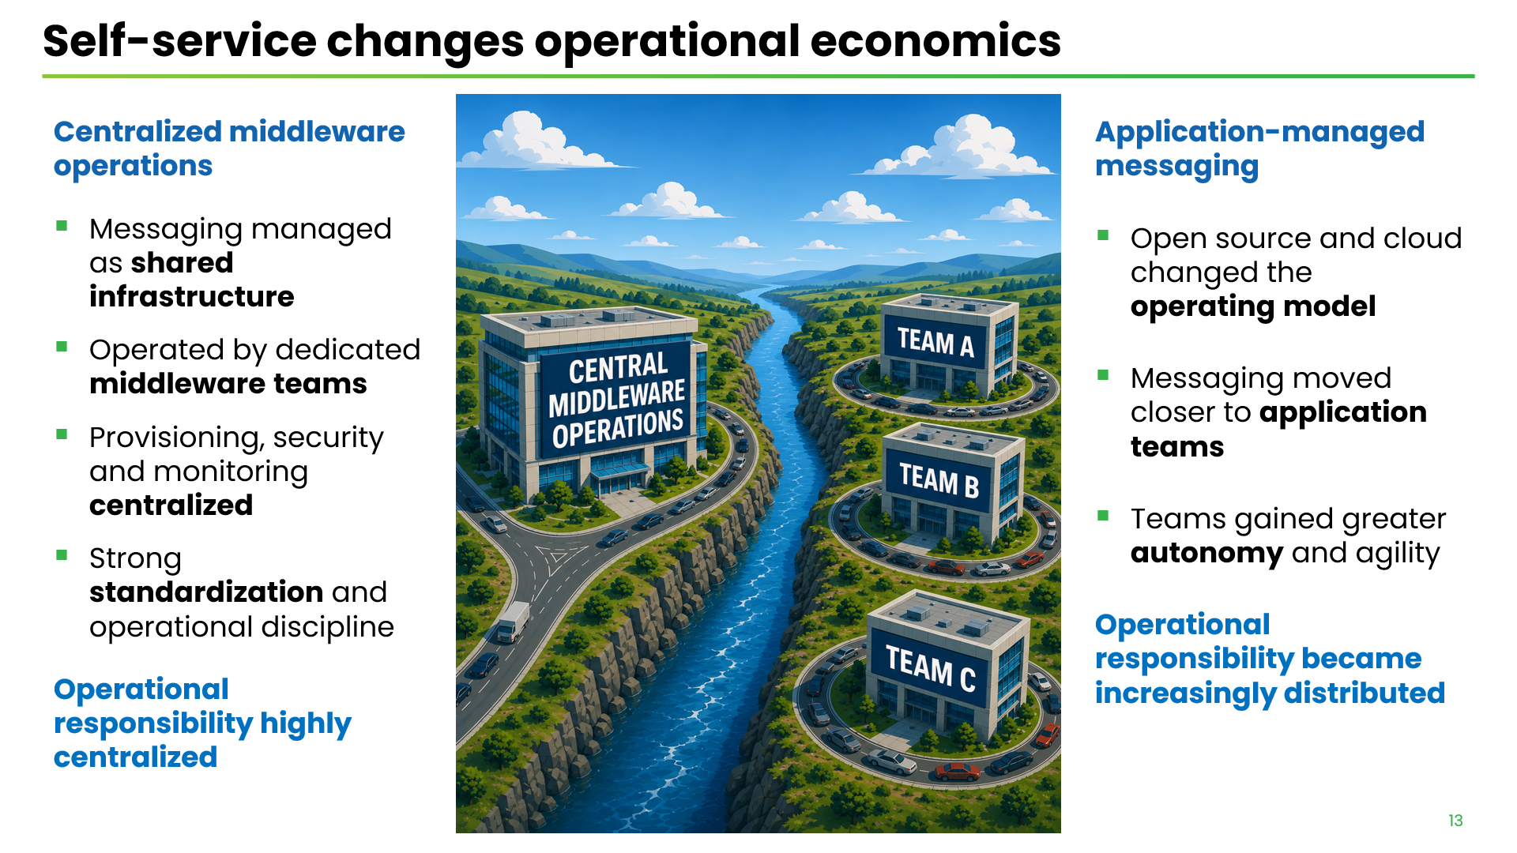
Notes:
TRADITIONALLY, messaging platforms were CENTRALLY MANAGED … (IBM MQ - classic example) …
… (bullet points) …
Operational RESPONSIBILITY was highly CENTRALIZED
Very GOOD REASONS for that model ... CONSISTENCY … STANDARDIZATION … OPERATIONAL DISCIPLINE around infrastructure that is BUSINESS-CRITICAL
MORE RECENTLY … widespread adoption of OPEN-SOURCE messaging technologies … CLOUD-NATIVE architectures … CHANGED messaging LANDSCAPE
… (bullet points) …
Operational RESPONSIBILITY became increasingly DISTRIBUTED
Very real BENEFITS … Application teams gained greater AUTONOMY … could move more quickly … became LESS DEPENDENT on a centralized middleware organization

Slide 14
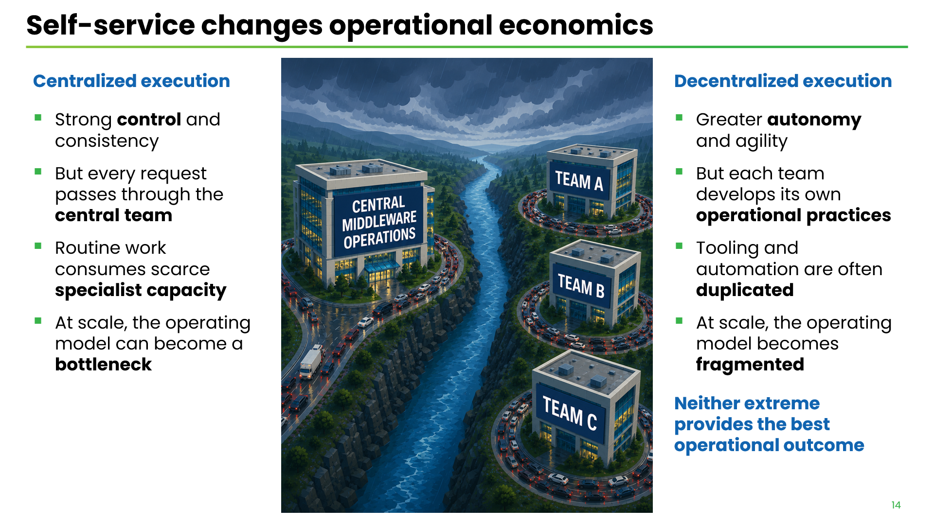
Notes:
BOTH of these operating models offer REAL BENEFITS ...
CENTRALIZATION … brings CONTROL, CONSISTENCY …
DECENTRALIZATION … gives application teams greater AUTONOMY and AGILITY
The PROBLEM appears when EITHER MODEL is taken to an EXTREME …
CENTRALIZED execution … (bullet points) …
DECENTRALIZED execution … (bullet points) …
The point … is NOT that CENTRALIZED operations are BAD or that DECENTRALIZED operations are BAD … it’s that NEITHER EXTREME PROVIDES THE BEST OPERATIONAL OUTCOME

Slide 15
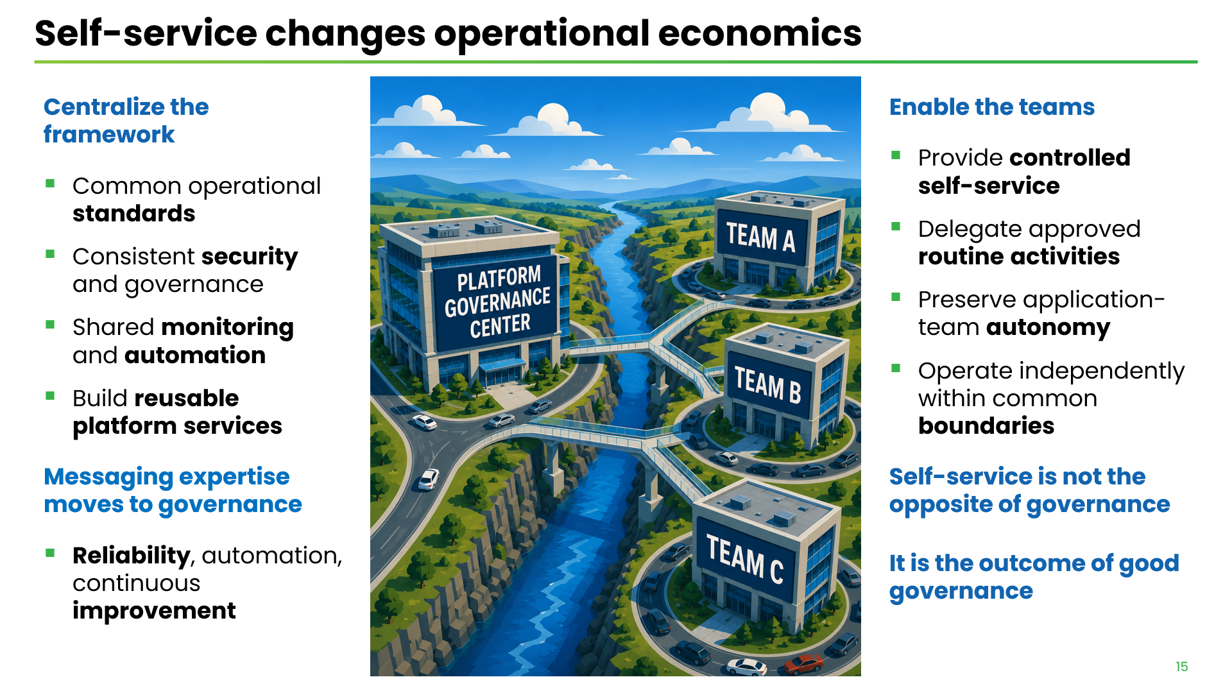
Notes:
We don't need to CHOOSE between these 2 models of governance … We can CAPITALIZE on the STRENGTHS of EACH model … We don’t CENTRALIZE the WORK … We CENTRALIZE the FRAMEWORK within which work is PERFORMED
Centralize the FRAMEWORK … (bullet points) …
ENABLE application TEAMS … (bullet points)
Messaging expertise moves to effective governance … (bullet points)
Self-service doesn't mean “LESS GOVERNANCE” … it is the OUTCOME of GOOD GOVERNANCE

Slide 16
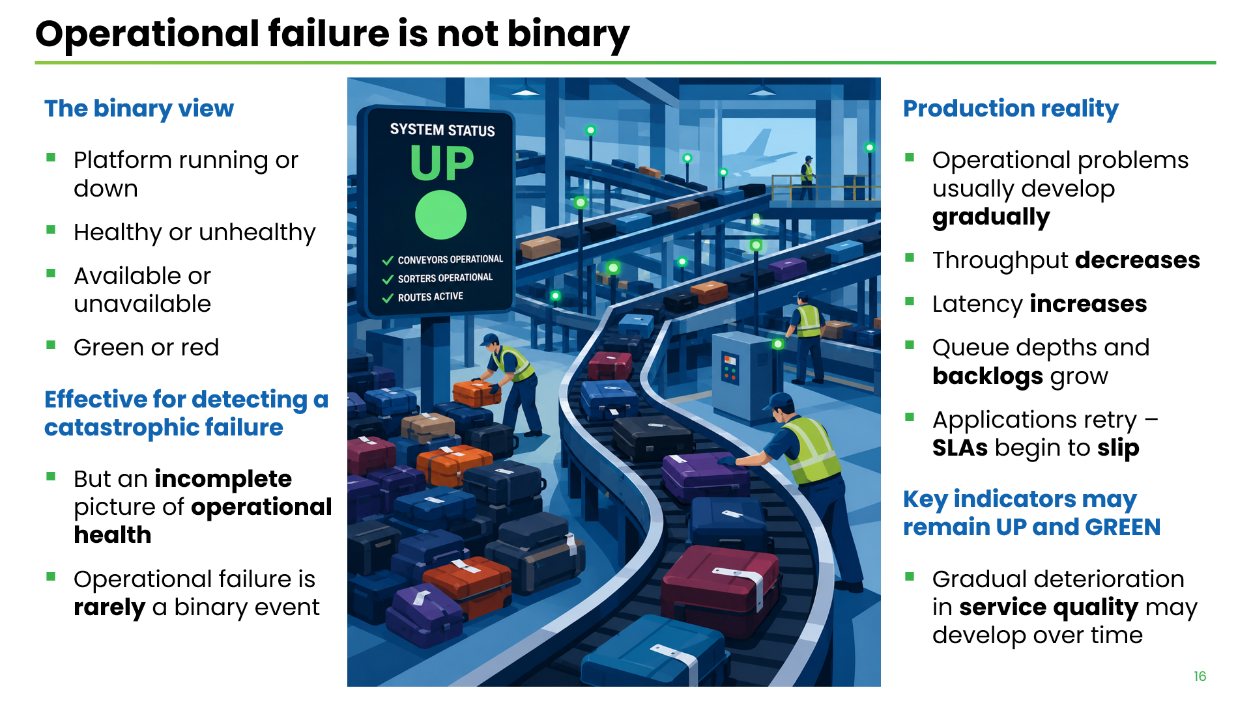
Notes:
We tend to think about OPERATIONAL FAILURE in BINARY terms … (bullet points) …
Effective ONLY for operational FAILURE … (bullet points) …
In PRODUCTION systems, the REALITY is … (bullet points) …
Key Indicators remain UP and GREEN … (bullet point) …
This is a PROBLEM … when QUALITY of SERVICE gradually DETERIORATES … organizations can start believing that it is NORMAL … this is where the LARGEST HIDDEN operational COSTS begin

Slide 17
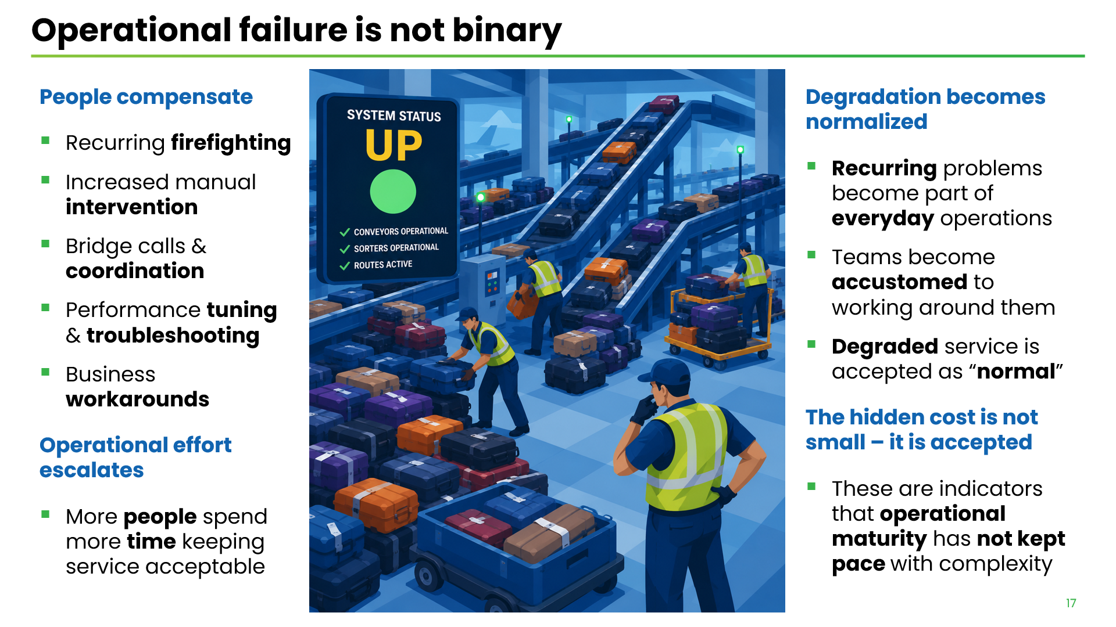
Notes:
What happens in these situations ? … Usually, PEOPLE COMPENSATE … (bullet points) …
OPERATIONAL effort ESCALATES … (bullet point) …
When this happens REPEATEDLY, PEOPLE GET USED TO IT … (bullet points) …
Hidden cost is NOT SMALL … HIDDEN BECAUSE it’s ACCEPTED … (1 bullet point) …
We may be MEASURING the WRONG THING … we might be REPORTING EXCELLENT AVAILABILITY … while the BUSINESS is EXPERIENCING something very DIFFERENT

Slide 18
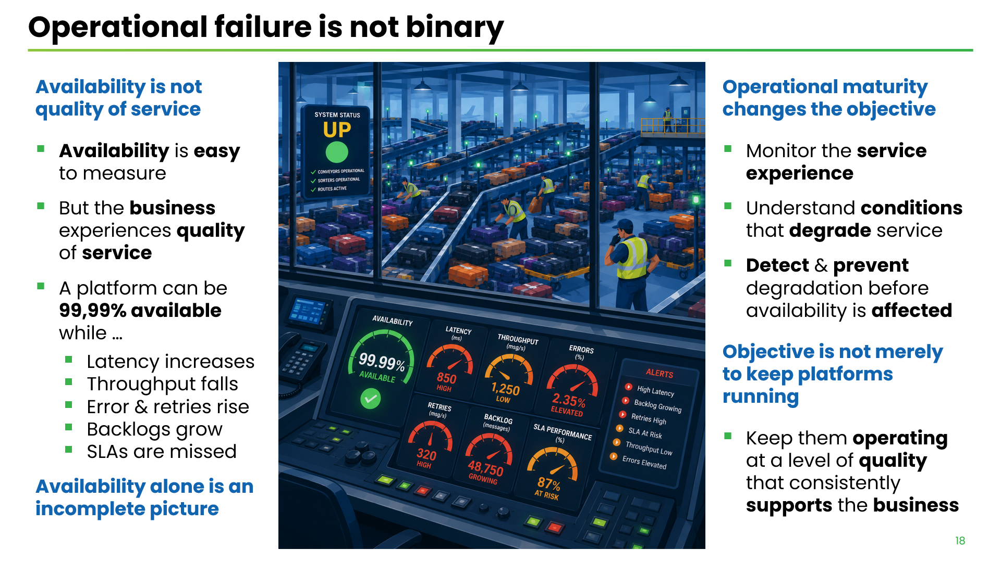
Notes:
AVAILABILITY is NOT QUALITY of SERVICE … (bullet points) …
AVAILABILITY ALONE gives us an INCOMPLETE PICTURE
OPERATIONAL MATURITY CHANGES the OBJECTIVE … (bullet points) …
Consistent with MODERN SITE RELIABILITY ENGINEERING. Google's FOUR GOLDEN SIGNALS — LATENCY, TRAFFIC, ERRORS and SATURATION —service health cannot be understood through availability alone
OBJECTIVE is NOT MERELY to keep messaging platforms RUNNING … (1 bullet point)

Slide 19
Notes:
… (title) …

